Slide 1

BLOCKCHAIN
TEAM MEMBERS :-
Hardik Agarwal
Mayank Johari
Ishika Rastogi

Slide 2
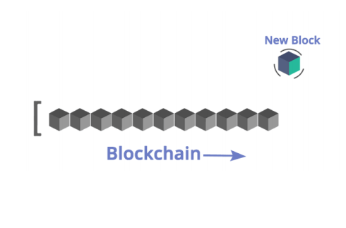
What is blockchain ?
“Open , distributed ledger that can record transactions between two parties efficiently and in a verifiable and permanent way”
Open
Distributed
Ledger
P2P
Permanent

Slide 3
HISTORY
2008
Idea was published under the pseudonym Satoshi Nakamoto
2009
Start of the Bitcoin Network
2010
Fist cryptocurrency stock exchange is launched
2011
One Bitcoin equals one USD
2013
1 Bitcoin equals
100 USD
2014
Microsoft accepts Bitcoin
2017
1 Bitcoin equals
10,000 USD

Slide 4
01
BlOCKCHAIN BASICS

Slide 5
BlockChain Basics
Mostly people think that Blockchain is Bitcoin and vice-versa. But it’s not the case. In fact, Bitcoin is a digital currency or cryptocurrency.
• Blockchain was invented by Satoshi Nakamoto.
• As the name suggests, blockchain is a chain of blocks that contains information.
• Each block consists of a number of transactions and each transaction is recorded in the form of Hash.
• Hash is a unique address assigned to each block during its creation and any further modification in the block will lead to a change in its
hash.

Slide 6
02
What is the need of bockchain ?

Slide 7
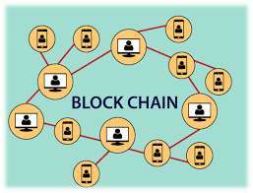
What is the need of block chain?
In a typical centralized system, there are many flaws, including:
• Can’t be fully trusted
• Doesn’t offer full security
• Isn’t concerned with privacy issues
• Transactions are complex and costly- Takes up too much time and costly.
• Prone to human error or fraud— each participant has its own separate ledger.
• Inefficient — intermediaries are needed for validation.
• Frequent delays & losses — paper-based and data stored locally by each party.
• No transparency

Slide 8
03
Types of blockchain

Slide 9
What are the types of blockchain
If we can classify the blockchain, then it would be based on two different scenarios. Typically in the
general classification, we get four types of blockchain – • Private- In the private blockchain, you’ll see only a single organization in the network. Basically, a single organization can select who is free to join the network and who can’t.
• Public- In this one, the blockchain technology companies will get full freedom. In reality, it means that anyone and everyone is free to join the network. There would be no restrictions whatsoever.

Slide 10
What are the types of blockchain
• Federated- Federated or Consortium blockchain technology is more or less the best of both worlds. However, in this case, you’ll see that it’s a bit close to private blockchains. In reality, the federated blockchain is a
decentralized private network.
Hybrid- Hybrid is kind of similar to federated blockchain, but they are surely different. In this case, Hybrid blockchain also uses the best of both worlds. However, here, it would indicate freedom and controlled access

Slide 11
04
Issues with current banking systems

Slide 12



ISSUES WITH CURRENT BANKING SYSTEM
High Transaction Fees
Rs 20 (2%)
Rs 1000
Rs 980
Trusted third party
(Govt. Banks)
Aman
Ram
JP Morgan Chase , Bank of America and Wells Fargo
alone earned more than $6 billion from ATM and over drafted fees in 2015
Source SNL Financial and CNNMoney report

Slide 13
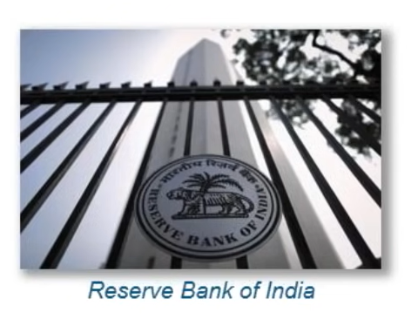
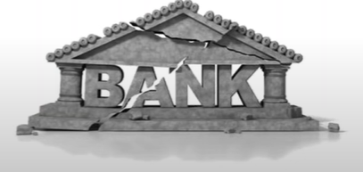
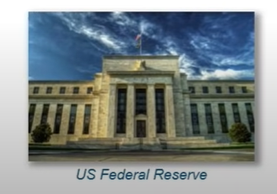
Bank Collapse
Banks have become synonymous with Crises and Crashes due to depression and fractional reserve banking

Slide 14

How Bitcoin Solves the issue

Slide 15
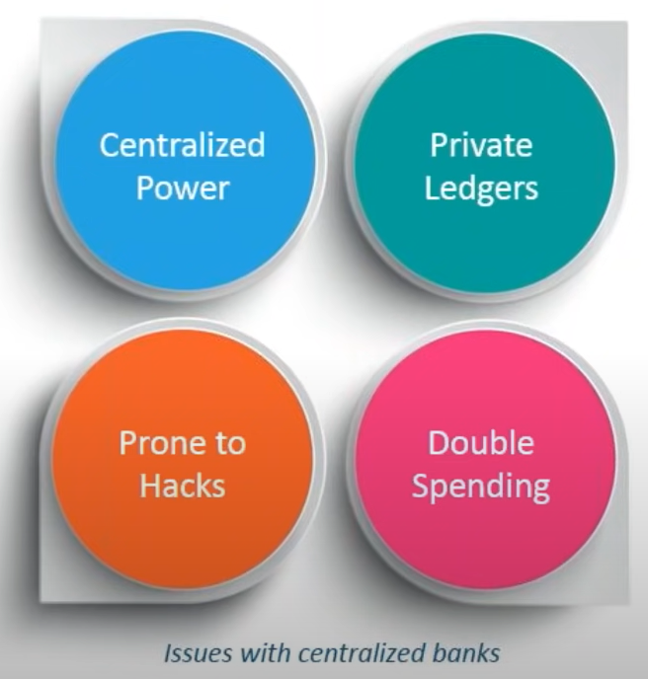
How Bitcoin Solves the issues
Bitcoin Blockchain has a distributed ledger
The ledger is public for all to access
Double Spending is not allowed because of the basic structure of block transaction
Transactions are immutable , thus cannot be hacked

Slide 16
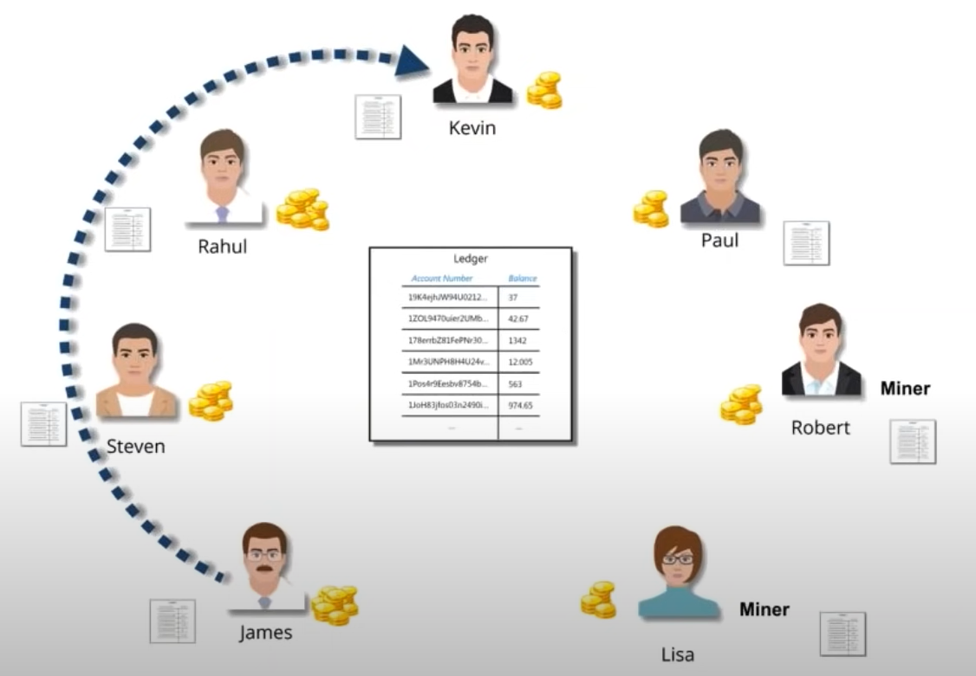
Bitcoin Transaction
1. Let us take a bitcoin transaction where James wants to transfer 500 BTC to Kevin
2.The transaction is a part of the new block that will be validated by miners Lisa and Robert

Slide 17
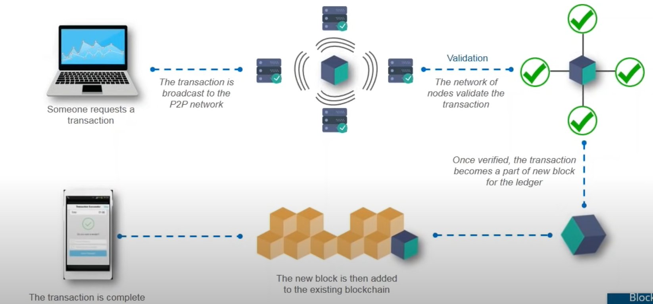
Blockchain flow diagram

Slide 18
05
BlOCKCHAIN CONCEPTS
Some some of the basic concepts of blockchan are given ahead

Slide 19
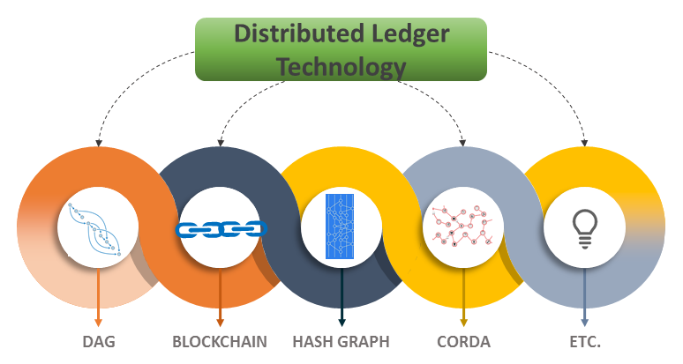
1. DISTRUBUTED LEDGER TECHNOLOGY
Distributed Ledger Technology (DLT) refers to the technological infrastructure and protocols that allows simultaneous access, validation, and record updating in an immutable manner across a network that's spread across multiple entities or locations.

Slide 20
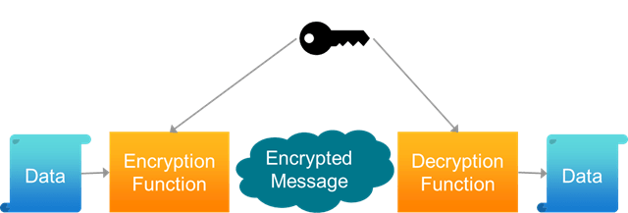
2. TRANSACTION VALIDATION
Transaction validation is the process of determining if a transaction conforms to certain protocol requirements to deem it as valid. Transaction validation is the process of determining if a transaction conforms to specific rules to deem it as valid.

Slide 21
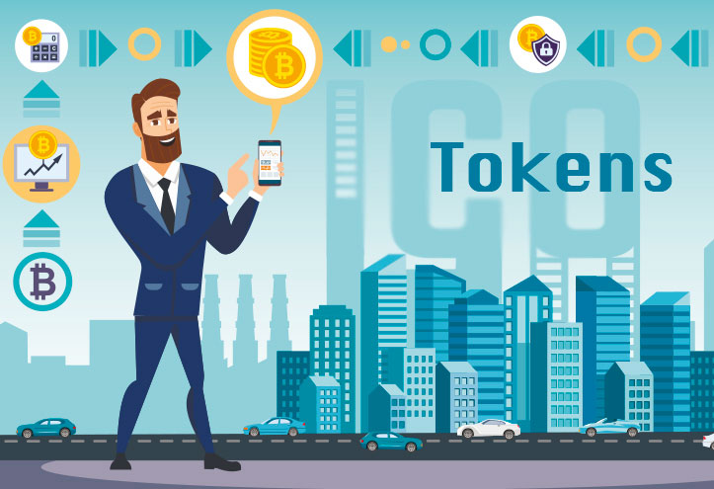
3. TOKENS
A digital asset used in a blockchain transaction. A token can be native to the blockchain, such as a cryptocurrency, or it can be a digital representation of an off-chain asset (known as a tokenised asset), such as the title to a house.

Slide 22
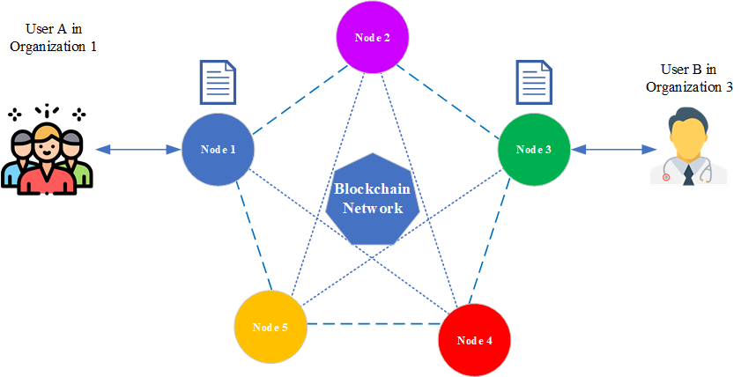
4. NETWORK NODES
Nodes represent agents or participants on a blockchain network, such as banks, government agencies, individuals, manufacturers or securities firms. Depending on the permissions set in the network, they may be able to approve, validate, send or receive transactions and data.

Slide 23
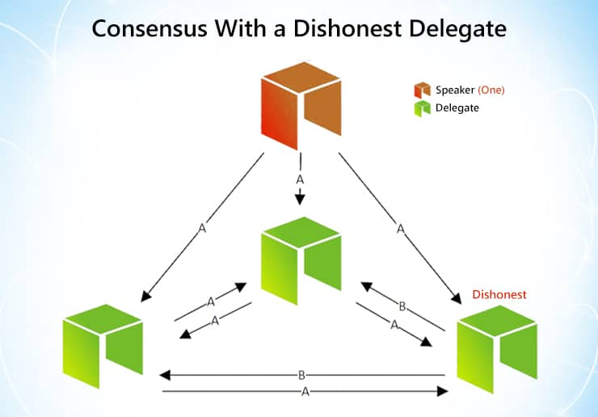
5. CONSENSUS PROTOCOL
A set of rules and processes that determine how nodes on a blockchain network reach agreement about a set of data and whether to approve, or validate, transactions in the network.

Slide 24
06
BLOCKCHAIN FEATURES
Some essential features of blockchan are given ahead

Slide 25
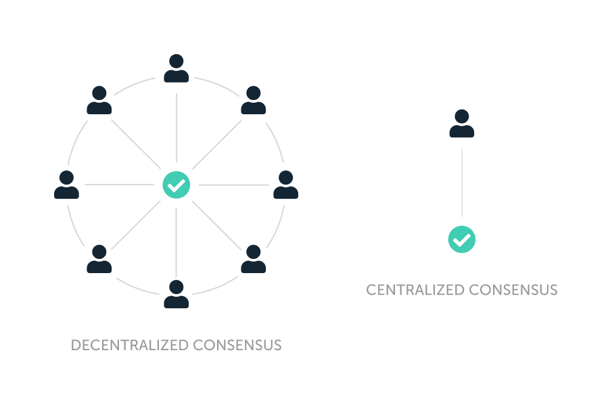
1. DISTRUBUTED CONSESUS
A distributed consensus ensures a consensus of data among nodes in a distributed system or reaches an agreement on a proposal.^{[2]}
A consensus algorithm may be defined as the mechanism through which a blockchain network reach consensus.
Public (decentralized) blockchains are built as distributed systems and, since they do not rely on a central authority, the distributed nodes need to agree on the validity of transactions.
This is where consensus algorithms come into play. They assure that the protocol rules are being followed and guarantee that all transactions occur in a trustless way, so the coins are only able to be spent once.

Slide 26
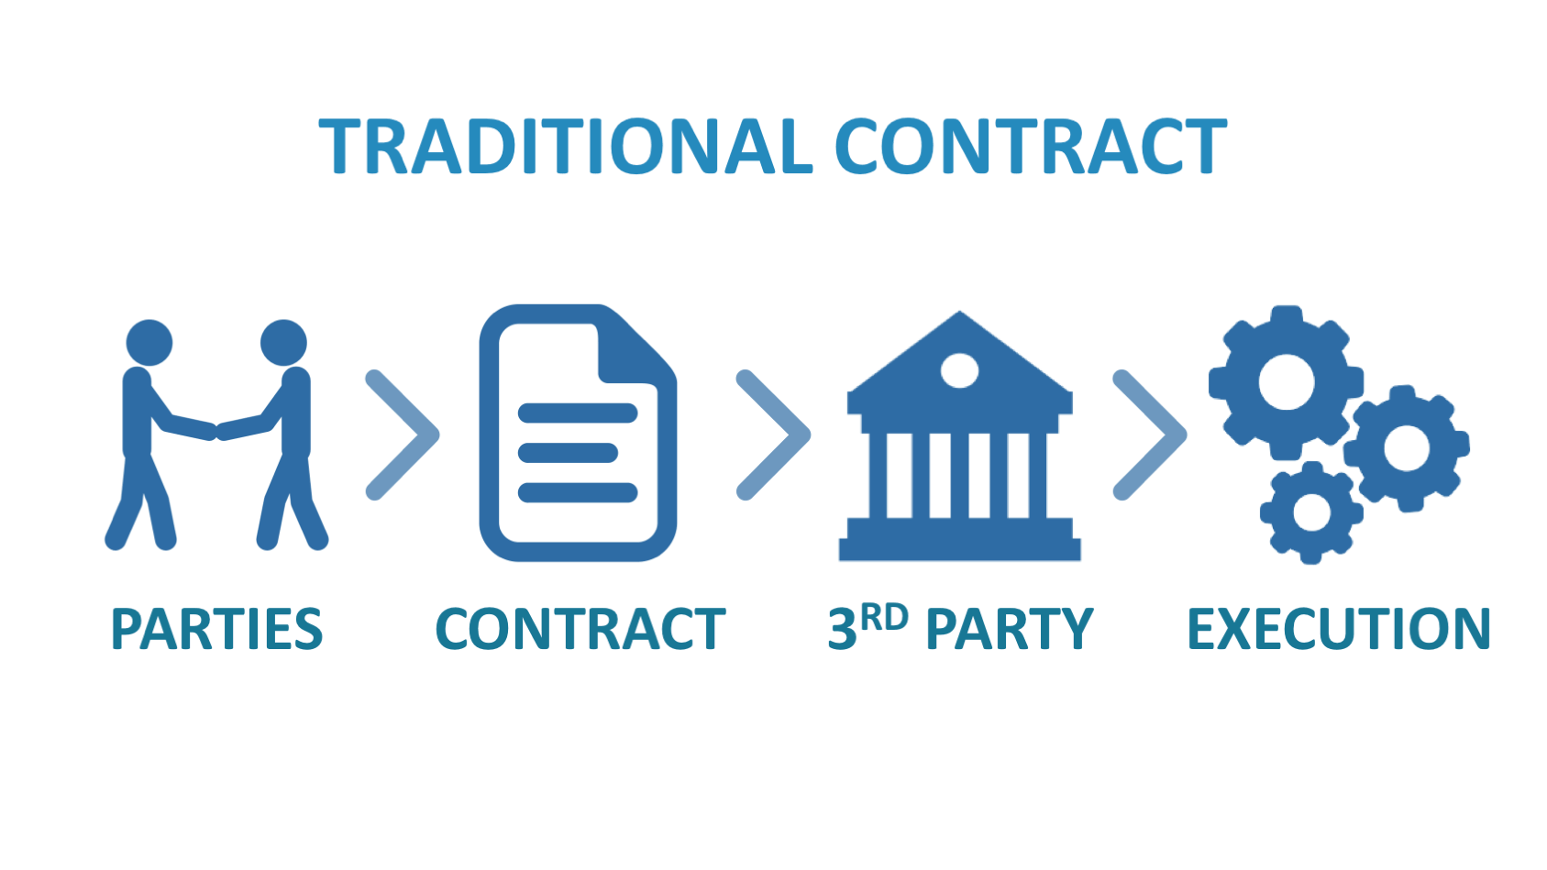
2. PLATFORM FOR SMART CONTRACT
Smart contracts are a revolutionary layer of blockchain technology that enables users to interact and perform transactions with each other through a ‘robotic intermediary.’ You can view a smart contract as a self-executable pile of code that can perform specific actions that usually need to be made manually.
Blockchain provides various platforms. Example : Ethereum , polkadot , solana.

Slide 27
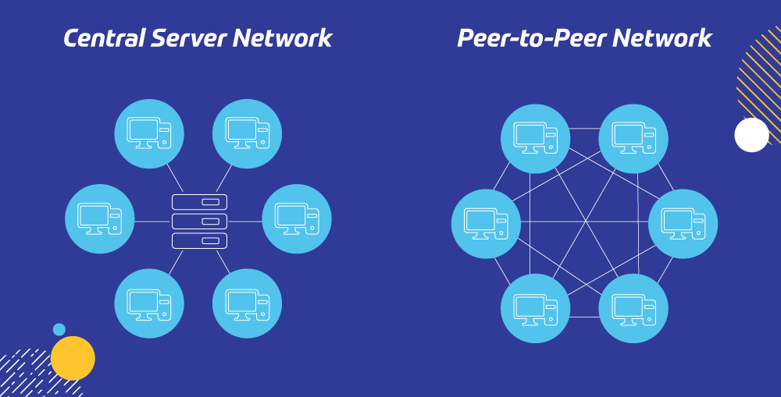
3. PEER TO PEER (P2P) NETWORK
The peer-to-peer architecture of blockchain allows all cryptocurrencies to be transferred worldwide, without the need of any middle-man or intermediaries or central server. ... Blockchain is a decentralized ledger tracking of one or more digital assets on a peer-to-peer network.

Slide 28
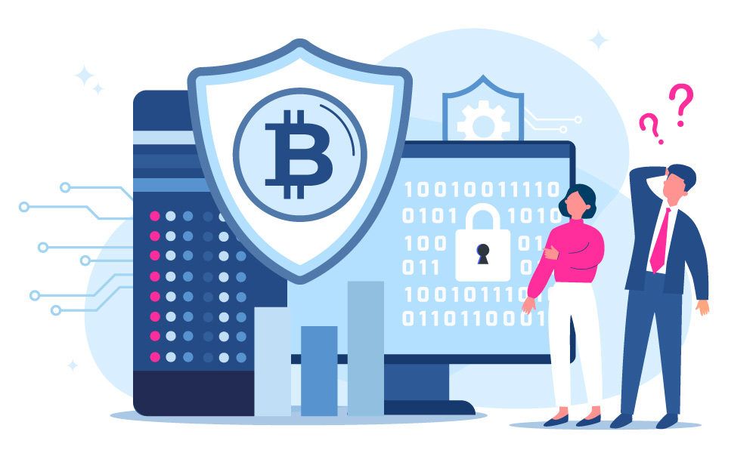
4. PROVIDER OF SECURITY
Blockchain technology produces a structure of data with inherent security qualities. It's based on principles of cryptography, decentralization and consensus, which ensure trust in transactions. ... Blockchain technology enables decentralization through the participation of members across a distributed network.

Slide 29
07
BLOCKCHAIN USE CASES
These are some of the example where blockchain is used

Slide 30
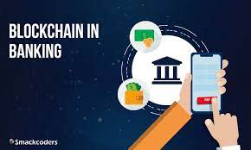
1. BLOCKCHAIN IN BANKING
Payments: By establishing a decentralized ledger for payments (e.g. Bitcoin), blockchain technology could facilitate faster payments at lower fees than banks. Clearance and Settlement Systems: Distributed ledgers can reduce operational costs and bring us closer to real-time transactions between financial institutions

Slide 31
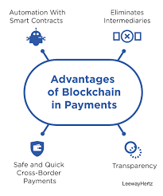
2. BLOCKCHAIN IN PAYMENTS AND TRANSFERS
Blockchain technology promises to facilitate fast, secure, low-cost international payment processing services (and other transactions) through the use of encrypted distributed ledgers that provide trusted real-time verification of transactions without the need for intermediaries such as correspondent banks

Slide 32
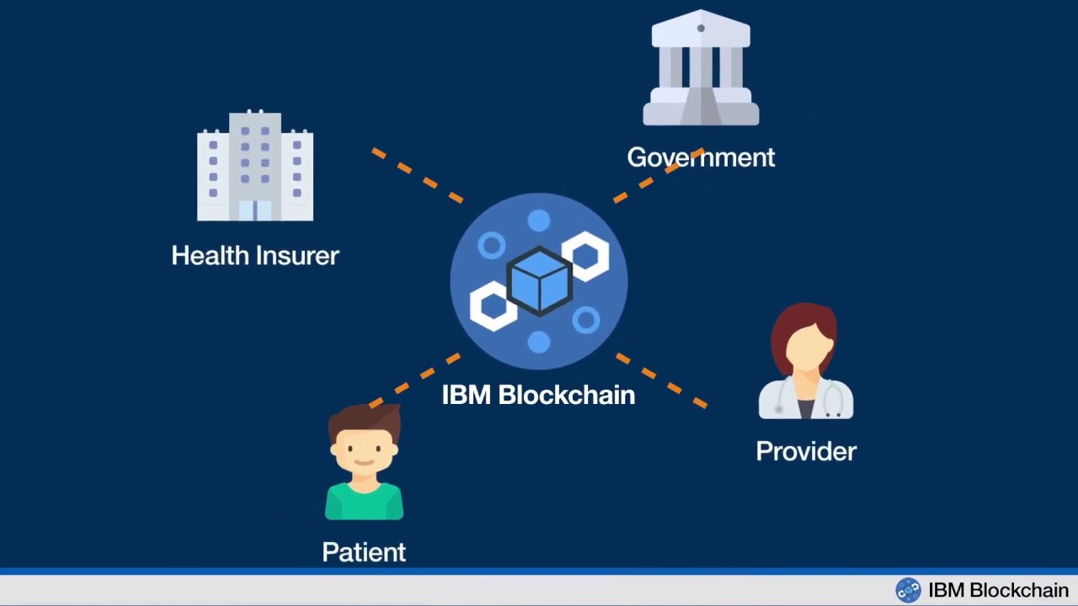
3. BLOCKCHAIN IN HEALTHCARE
Electronic medical records stored in a blockchain accessed and uploaded via biometrics, allow for the democratization of patient data and alleviate the burden of transferring records among providers.

Slide 33
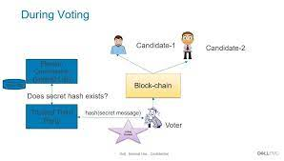
4. BLOCKCHAIN IN VOTING
There has been a trend of moving to decentralized voting systems, such as those based on blockchain. The latter is a decentralized digital ledger in a peer-to-peer network, where a copy of the append-only ledger of digitally signed and encrypted transactions is maintained by each participant. Therefore, in this article, we perform a comprehensive review of blockchain-based voting systems and classify them based on a number of features (e.g., the types of blockchain used, the consensus approaches used, and the scale of participants).

Slide 34
THANKS!

